Slide 1



Department of Computer Science and Engineering A CNN-BASED STRUTURE FOR CORRELATION OF CONTACTLESS TO CONTACT-BASED FINGERPRINTS USING NETWORK SECURITY
BATCH- 2 TEAM MEMBERS
Chennareddy Sushmitha Reddy (2019PECCS200, 211419104047)
Marella Mansi (2019PECCS164, 211419104161)
Priyadharsini P (2019PECCS166, 211419104203)
Guide Name & Designation
Coordinator Name & Designation
Dr. A. Hemlathadhevi, ME, PhD
Dr. K. Valarmathi, ME, PhD

Slide 2

INTRODUCTION
Comparison of contactless fingerprint images with contact-based fingerprints is critical for the success of emerging contactless fingerprint technologies.
This offer more hygienic and deformation-free acquisition of fingerprint features.

Slide 3

Objective of the Project
To investigate the minutae based fingerprint identification.
It can be utilized in various applications that use biometrics systems like computers, mobile phones, office attendance machines. This method takes less time to process

Slide 4
LITERATURE SURVEY
YEAR | TITLE AND JOURNAL | AUTHOR | DESCRIPTION | ADVANTAGES | DISADVANTAGES
2023 | “Towards More Accurate Matching of Contactless Fingerprints With a Deep Geometric Graph Convolutional Network”,in IEEE Access | Yelin Shi, Zhao Zhang, Shuxin Liu, and Manhua Liu | It proposed a fingerprint matching algorithm which combined the coordinates, orientation and quality information of minutia to calculate minutiae correspondences. | Towards more accurate matching of contactless fingerprints, it proposes a deep geometric graph neural network to jointly learn the multi-level minutia features and their similarities in an end-to-end fashion | Accurate matching of contactless fingerprints is still challenging due to the inevitable perspective distortions and variations of illumination and poses.

Slide 5
2023 | “Methods and Applications of Fingertip Subcutaneous Biometrics Based on Optical Coherence Tomography” | Yang Yu, Haixia Wang , Yilong Zhang , Ronghua Liang , and Peng Chen | It provides a review to comb the whole process of fingertip subcutaneous biometrics from collection, extraction to application systematically . | the fingerprint biometric features based on OCT, mainly internal fingerprints and sweat glands, have better identification and anti-counterfeiting performance than the traditional external fingerprints and skin sweat pores. | The performance balance of the system, such as resolution and detection depth, sensitivity and speed, needs to be optimized.The internal fingerprint extracted by OCT also has some shortcomings.

Slide 6
YEAR | TITLE AND JOURNAL | AUTHOR | DESCRIPTION | ADVANTAGES | DISADVANTAGES
2022 | “A CNN-based Framework for Comparison of Contactless to Contact-based Fingerprints”,in IEEE Access | Chenhao Lin, Ajay Kumar | It consistently achieves outperforming results, over several popular deep learning architectures and over contactless to contact-based fingerprints comparison methods. | It incorporates most reliable minutiae features along with the respective ridge flow maps to ensure robustness in the learning minutiae feature correspondences | The limitations in the matching accuracy from the proposed method can be observed from the falsely rejected genuine fingerprints and falsely accepted imposter fingerprints.

Slide 7
2022 | “C2CL: Contact to Contactless Fingerprint Matching”,in IEEE TRANSACTIONS ON INFORMATION FORENSICS AND SECURITY,VOL. | Steven A. Grosz , Joshua J. Engelsma , Eryun Liu , ,and Anil K. Jain | It presents an end-to-end automated system, called C2CL, comprised of a mobile finger photo capture app, preprocessing, and matching algorithms to handle the challenges inhibiting cross-matching methods | the cross- database evaluation is a much better measure of how C2CL would perform in the real world. | the low error rates which is achieved achieved across each dataset, there are many factors that complicate the cross-matching performance and lead to both false rejects and false accepts errors.

Slide 8

PROBLEM STATEMENT
To create a Convolutional Neural Network (CNN) that can accurately identify fingerprints images of an individual.
To create the best model architecture and improve the model accuracy.
The Minutiae extraction module is used for extracting the minutiae points from the pre-processed fingerprint images. This involves applying ridge thinning algorithms, minutiae detection algorithms.

Slide 9

EXISTING SYSTEM
It defines a method that only concentrates on Matching minutiae feature vector but not whole topology.
Hard to compare from low quality fingerprint images.
This approach simply matches minutiae points without providing any additional layer of security.

Slide 10
DISADVANTAGES
This indicates that the fingerprint comparison performance drops dramatically while matching the fingerprints acquired from different sensors , especially for the fingerprints acquired from contactless and contact-based sensors.

Slide 11
PROPOSED SYSTEM
The overall goal for the method presented here is to estimate an equivalent synthetic contact-based fingerprint from a contactless fingerprints.
It defines a method that concentrates on Matching minutiae feature vector and whole topology.

Slide 12

PROPOSED SYSTEM(CONTD…)
It presents an algorithm for fingerprint recognition based on the topological analysis of the ridge pattern through persistence homology.
The topological information was used to improve the description of fingerprints local structures in combination with other geometrical features.

Slide 13
ADVANTAGES
The solution have wide applications, especially in areas like forensics, bank and e-business.
It is a model for business transaction to authentication in 3 layers using the fingerprints.

Slide 14
SYSTEM REQUIREMENTS
Operating System : Windows 10 or later
Tool : NetBeans
Processor : Intel i3
Hard disk : Minimum 80 GB
RAM : Minimum 4 GB

Slide 15
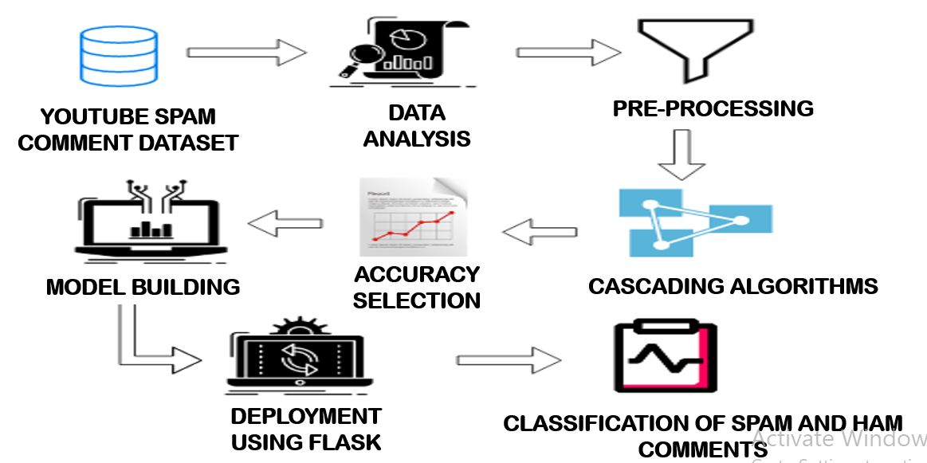
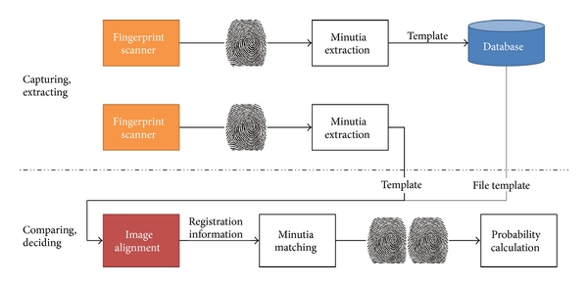
ARCHITECTURE DIAGRAM

Slide 16
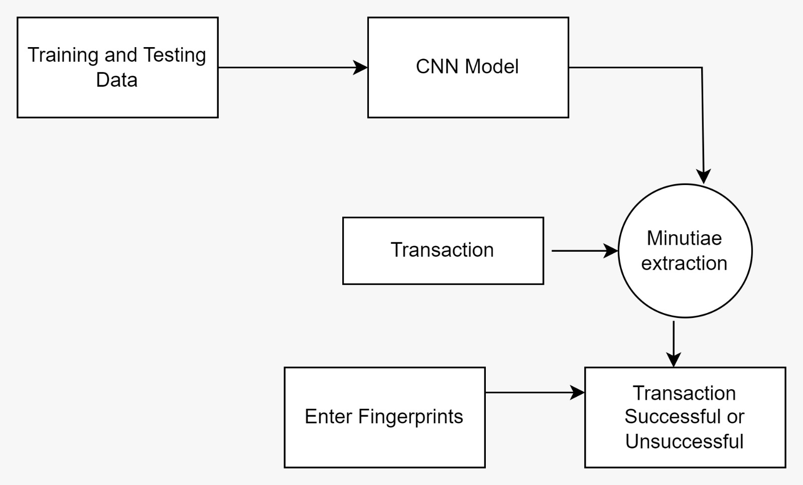
DATAFLOW DIAGRAM

Slide 17
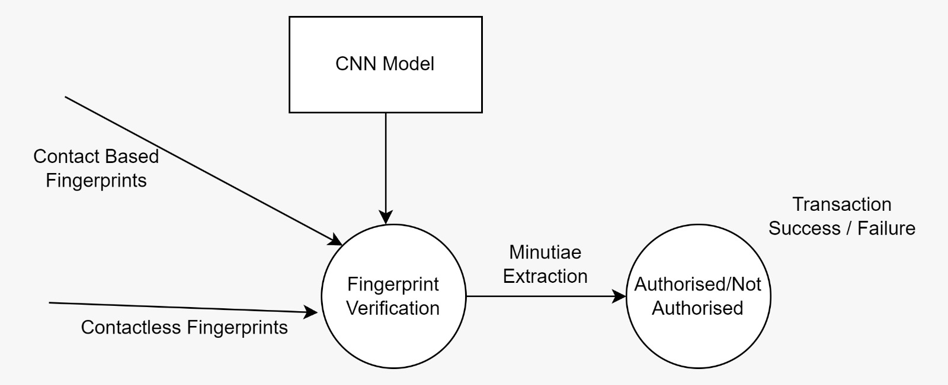
DATAFLOW DIAGRAM(CONTD…)
Level 2 DFD:

Slide 18
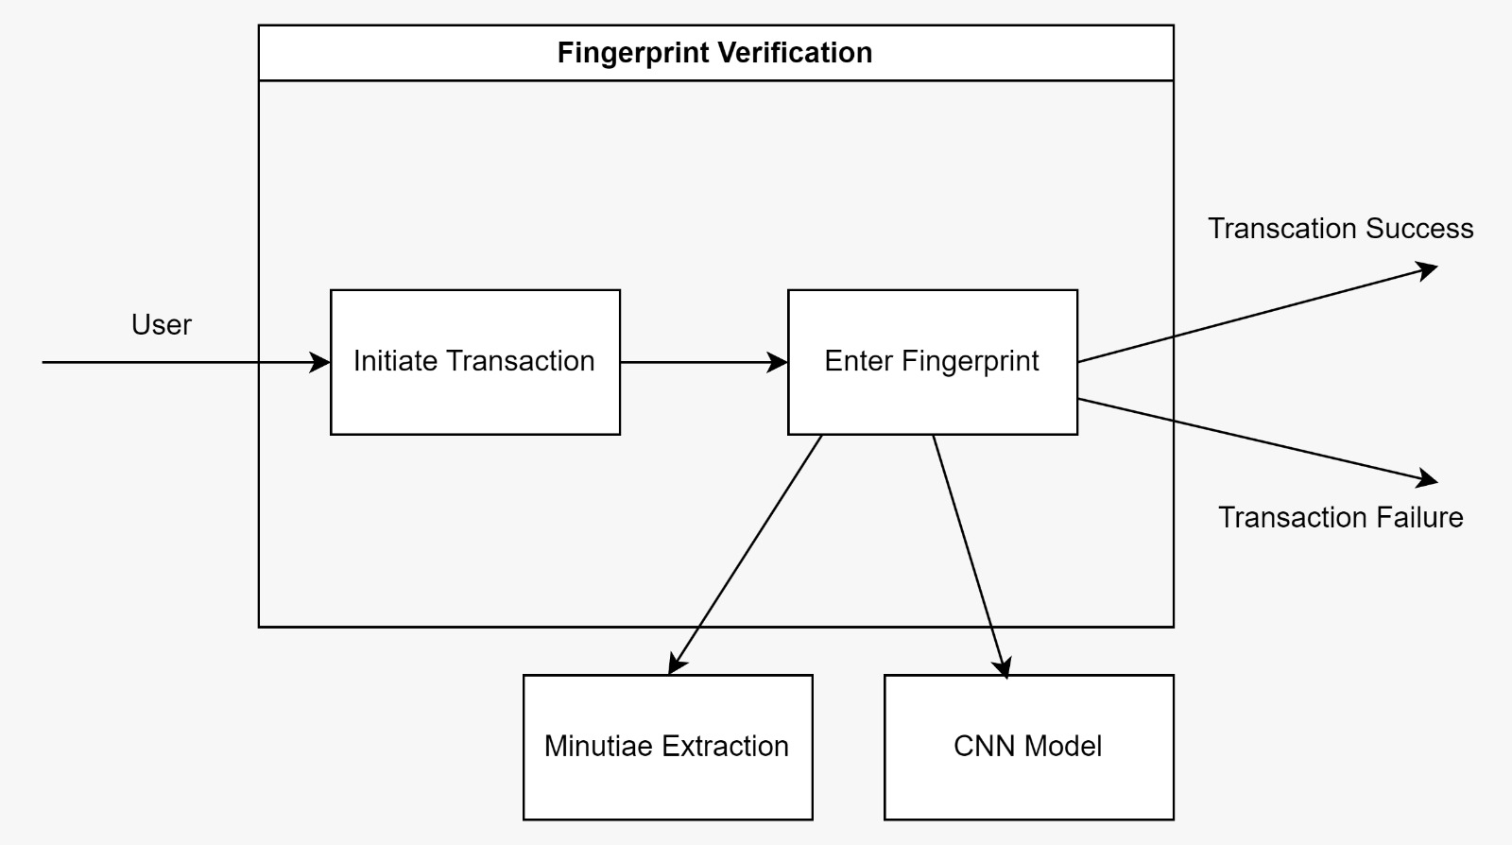
DATAFLOW DIAGRAM(CONTD…)

Slide 19
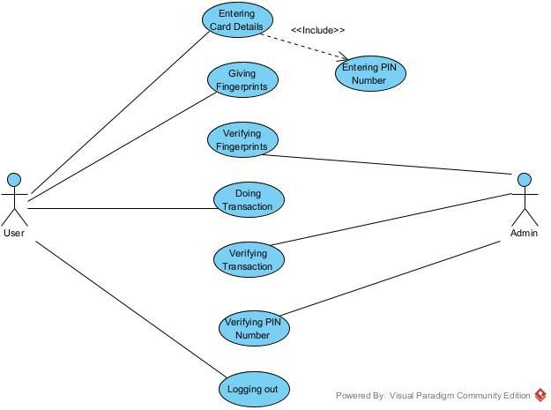
USE CASE DIAGRAM

Slide 20
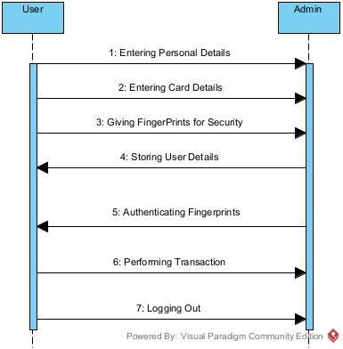
SEQUENCE DIAGRAM

Slide 21
MODULE DESCRIPTION
Module 1: Preprocessing
Module 2: Minutiae feature extraction
Module 3: Fingerprint Authentication
Module 4: Secured bank transaction

Slide 22
Preprocessing
In fingerprint recognition system preprocessing of a finger print is done to improve the fingerprint quality before extracting necessary information for the comparison phase.
The grayscale transformation in preprocessing allows us to reduce the space used for recording data included in the image; in fact, the color pixels require 24 bits to be able to represent the different levels of colors, on the other hand in grayscale we only need 8 bits for each pixel since we have only 256 gray levels.
The normalization operation makes it possible to increase the contrasts in the image by making a certain adjustment to the gray levels without affecting the useful information included in the fingerprint image.
Segmentation is the last step in preprocessing aims to minimize the noise present in the fingerprint image.

Slide 23
Minutiae feature extraction
Minutiae extraction algorithm
The minutiae based algorithm is widely used for fingerprint authentication. One of the significant parts of this algorithm is the classification of fingerprints which allows minimizing significantly the number of fingerprints referenced for each identification procedure.
The fingerprint feature extraction process aims at finding various minutiae points in a fingerprint to use them further for fingerprint matching.

Slide 24
CN=0.5∑ | Pi - Pi+1 |
i=1
where P9=P1. It is defined as half the sum of the differences between pairs of adjacent pixels in the eight neighborhood. Using the properties of the CN, the ridge pixel can then be classified as a ridge ending, bifurcation or non-minutiae point. For example, a ridge pixel with a CN of one corresponds to a ridge ending, and a CN of three corresponds to a bifurcation.

Slide 25
Fingerprint Authentication
After extraction for a given pair of contact and contactless fingerprint images ,we compute a final match score as a weighted fusion of the individual scores .
Finally , based on that similarity score the comparison between fingerprints is done.

Slide 26
Secured bank transaction
To protect the security of accounts, verify your address before we can send you payment. To do so, we mail a Personal Identification Number (PIN) to your payee profile address.
You’ll then need to enter this PIN within your account.That can be used to authenticate the user to the system

Slide 27
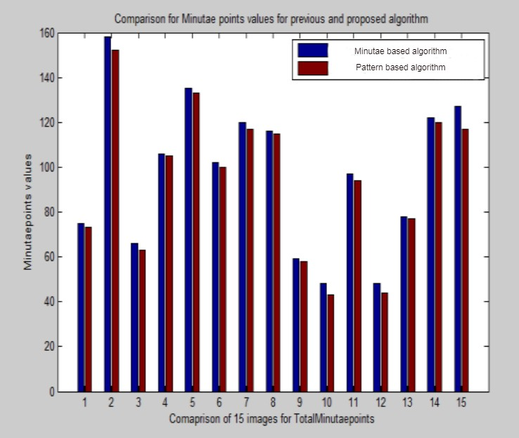
RESULTS
More minutiae points are detected in this algorithm as it focuses on whole topology of fingerprint. If more points are detected it's easy to match the fingerprint

Slide 28

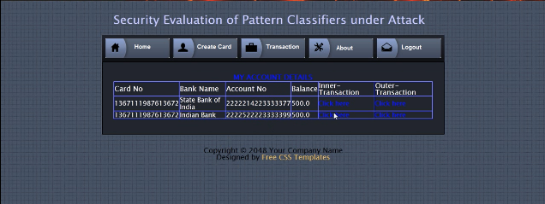
OUTPUT(CONTD…)
.

Slide 29
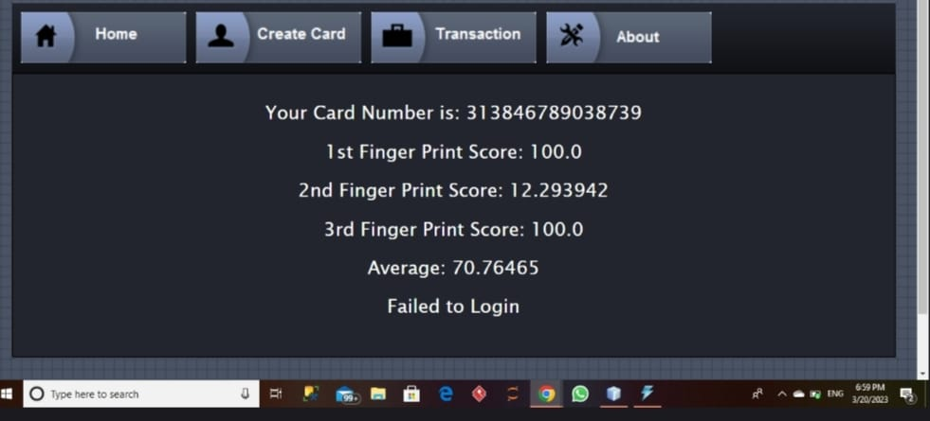
OUTPUT(CONTD…)

Slide 30
CONCLUSION
The development in contactless fingerprint recognition, though little has been explored.
Commercial facilities, border crossing areas, airports, and government access points are also employing contactless fingerprint biometrics.
Further, credit card account fraud, hijacking of websites, and most importantly, the critical corruption of governmental agencies are the Department of Defence and the Department of Homeland Security require the development of systems for which contactless fingerprint biometrics can be a solution the minutia set is organized with a graph and the geometric graph CNN is built to pass and aggregate minutiae features along the edges.

Slide 31
REFERENCES
[1] Chenhao Lin, Ajay Kumar,”A CNN-based Framework for Comparison of Contactless to Contact-based Fingerprints”,in IEEE TRANSACTIONS ON INFORMATION FORENSICS AND SECURITY,VOL.14,NO.3,pp.662-676,2022,DOI: 10.1109/TIFS.2022.2854765.
[2] Yelin Shi, Zhao Zhang, Shuxin Liu, and Manhua Liu, Member, “Towards More Accurate Matching of Contactless Fingerprints With a Deep Geometric Graph Convolutional Network”,in IEEE Transactions on Biometrics, Behavior, and Identity Science,VOL. 5, NO. 1, pp.29-38 JANUARY 2023,DOI:10.1109/TBIOM.2022.3219842.
[3] Steven A. Grosz , Joshua J. Engelsma , Eryun Liu , ,and Anil K. Jain , Life Fellow,IEEE,”C2CL: Contact to Contactless Fingerprint Matching”,in IEEE TRANSACTIONS ON INFORMATION FORENSICS AND SECURITY,VOL. 17,pp.196-210,2022,DOI:10.1109/TIFS.2021.3134867.

Slide 32

THANK YOU

